Slide 1
I just met you, and 'this' is crazy, but here's my NaN, so call(me) maybe?
JavaScript you so funny
Rachel Appel
http://rachelappel.com
rachel@rachelappel.com
@RachelAppel

Slide 2
What makes JavaScript fun? (and by fun I mean....a little bit strange)
JavaScript
Blocks
Functions
Null
Equality
Truthy/Falsey
Objects
this!
Eval
parseInt
NaN
With
JSLint/JSHint
Arrays
Switches
dates
more...

Slide 3
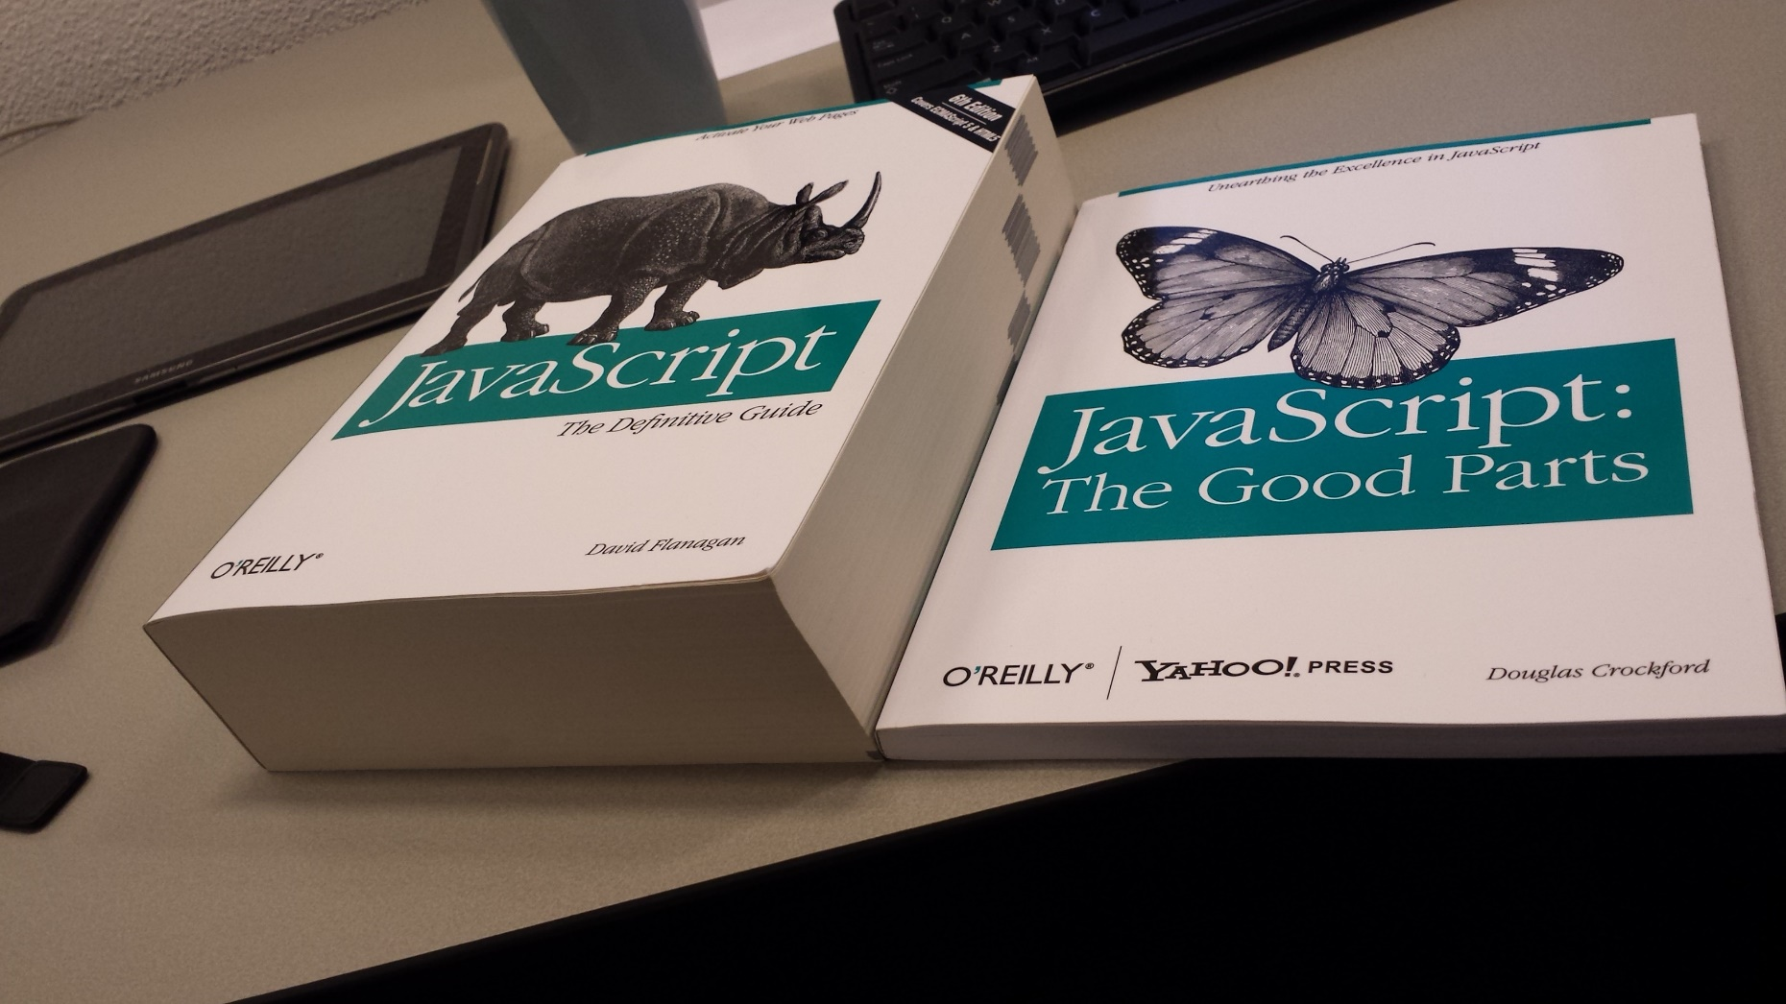
http://i.imgur.com/wR3ZxfB.jpg
Notes:
Image Source http://i.imgur.com/wR3ZxfB.jpg

Slide 4
JavaScript
I Love it
I Love to make fun of it more

Slide 5
JavaScript
...is not Java
Java is to JavaScript as...
car is to carpet
ham is to hamster
iron is to irony
taco is to Tacoma
Alf is to Gandalf
pot is to potato

Slide 6
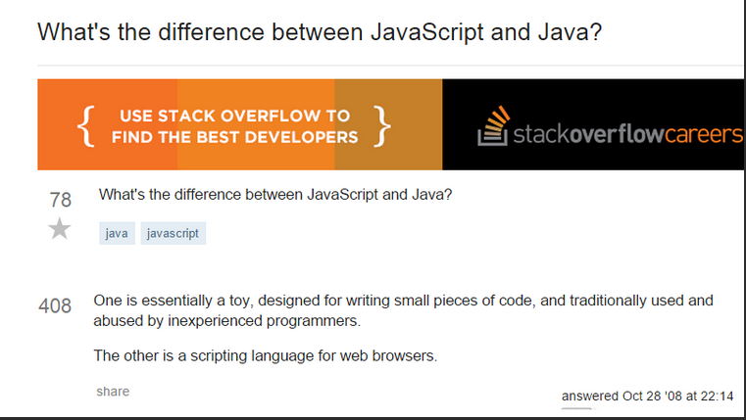

Slide 7
JavaScript….
has no class
it's so proto-typical
Finally, after many years, ES6 will support classes
Class comes with maturity
Notes:
you make prototype objects, and then … make new instances. Objects are mutable in JavaScript, so we can augment the new instances, giving them new fields and methods.
https://developer.mozilla.org/en-US/docs/Web/JavaScript/Introduction_to_Object-Oriented_JavaScript

Slide 8
DEMO
Prototypes

Slide 9
The DOM
…is a problem
Browser incompatibilities
Malformed HTML

Slide 10
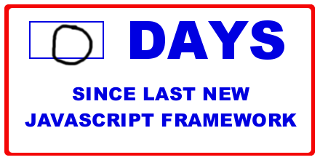

Slide 11
Syntax silly (automatic insertion)
Most often, a newline (\n) ends a statement unless...
The statement has an unclosed parenthesis ")", array literal, or object literal.
The line uses -- or ++
Any block statements such as for, while, do, if, or else,
or there is no starting bracket "{"
After these constructs: break, continue, return, throw

Slide 12
Syntax Silliness...ASI Affects these:
empty statement
var statement
expression statement
do-while statement
continue statement
break statement
return statement
throw statement

Slide 13
ASI
return
"something";
(how the dev sees it)
return;
"something";
(how the parser sees it)

Slide 14
DEMO
Automatic Demo

Slide 15
var a; var b; var c;
// Somewhat Readable
if (a===true)
alert(a); //On on IF
alert(b); //Always
// Not so readable
if (a===true)
alert(a); //runs if a is true
alert(b); //Always runs
// Somewhat Readable
if (a===true)
if (b===true)
alert(a); //Only runs if both are true
alert (b); //Always runs
// Not so readable
if (a===true)
if (b===true)
alert(a); //Only runs if both are true
alert (b); //Alwaysruns

Slide 16
Increment/Decrement Operators
value = value + 1;
--
++
If the operator appears before the variable, the value is modified before the expression is evaluated.
If the operator appears after the variable, the value is modified after the expression is evaluated.
In other words,
given j = ++k;, the value of j is the original value of k plus one;
given j = k++;, the value of j is the original value of k, which is incremented after its value is assigned to j.
Notes:
BE AWARE
If the operator appears before the variable, the value is modified before the expression is evaluated. If the operator appears after the variable, the value is modified after the expression is evaluated. In other words, given j = ++k;, the value of j is the original value of k plus one; given j = k++;, the value of j is the original value of k, which is incremented after its value is assigned to j.
pre & postfix behave differently
var x = 5; var y = ++x; console.log(y); console.log(x); // 5 & 5
var x = 5; var y = x++; console.log(y); console.log(x); // 5 & 6
var x = 5; var y = --x; console.log(y); console.log(x);
var x = 5; var y = x--; console.log(y); console.log(x);

Slide 17
DEMO
Increment and Decrement

Slide 18
Putting the "fun" in functions
Functions are first class
Named and Anonymous
Statement and Expression
Immediate or delayed execution

Slide 19
Named Functions
Statement
Expression
function echo(what) {
return thing;
}
var result = echo(what) {
return thing;
}
(function echo(what) {
return thing;
})();
var result = echo(what) {
return thing;
} ();
Immediately Invoked function

Slide 20
Anonymous Functions
Statement
Expression
function () {
return thing;
}
var result = () {
return thing;
}
(function () {
return thing;
})();
(var result = () {
return thing;
}(thing);
Immediately Invoked function

Slide 21
Putting the "fun" in functions
var result = functionStatement();
function functionStatement() {
// Some code
return value;
}
OK
var result = functionExpression();
var functionExpression = function() {
// Some code
return value;
};
Nope
Nope
Nope
Notes:
Sometimes JS treats a function like a value and sometimes it treats it as an executable block of code. This is why we have both functions statement and function expression. Let's dig into each:
-The function statement
hoisted
Syntactically the function statement starts with the function keyword then names the function end encloses the function contents with brackets.
Use a function statement to declare a function that you will use later. The code in between the brackets will not execute until the function is called from somewhere else. Inside of a function statement we use the return keyword to return a value to the calling code. Functions statements load at parse time before any code is executed.
Function expressions, on the other hand, loads when the interpreter reaches that line of code. – that means they load at runtime.
So if you try to call a function expression before it's loaded, you'll get an error. But if you call a function declaration, it'll always work. Because no code can be called until all declarations are loaded.

Slide 22
DEMO
Fun with functions
Notes:
Let's see JavaScript run some functions and determine the difference in loading between statements and expressions.
As you can see here in the demo, we have a web page in IE on the left and the IE debug tools on the right.
The developer tools show an html page containing a single button that runs some script.
In its corresponding JS file we see the declarations for all 3 function types starting with a
function statement the top of the file that returns a string into a variable named "s" in the calling code.
The function expression does the same by returning a string with the value "function expression" in it, and it returns that value into a variable named "e". In this case we are using both the function statement and expression the same way.
These two functions sit alongside an IIFE, which does not return any value as its job is to run the code immediately.
let's create a breakpoint, and see these dynamics in action. But before we do, let's take note that the call to the function expression happens before its location so that should error. I'll hit F5 now.
As you can see, the code doesn't even make it to the break point.
The function statement runs as you'd expect. The expression does not. This is because its trying to call the function expression before it loads, and expressions load where they are located in code – so it's not loaded yet.
If we swap the call and declaration of the function expression, then it should work.
Let's try running the code again.
We see it makes it to the breakpoint, so we know the expression has worked. Let's continue running and take a look at the IE output console, we can see that all three functions run, including the IIFE that ran with no need to call it.

Slide 23
Global
<script src="1.js">
var a, b, c
<script src="2.js">
var a, b, c
<script src="3.js">
var a, b, c
<script src="4.js">
var a, b, c
Window object
Global namespace pollution

Slide 24
DEMO
Global Rachii

Slide 25
Scope & Closures
Block syntax but not block scope
Variables created in a block are available in the entire function
Notes:
A closure is a special kind of object that combines two things: a function, and the environment in which that function was created. The environment consists of any local variables that were in-scope at the time that the closure was created.

Slide 26
DEMO
Closures
Notes:
Let's see JavaScript run some functions and determine the difference in loading between statements and expressions.
As you can see here in the demo, we have a web page in IE on the left and the IE debug tools on the right.
The developer tools show an html page containing a single button that runs some script.
In its corresponding JS file we see the declarations for all 3 function types starting with a
function statement the top of the file that returns a string into a variable named "s" in the calling code.
The function expression does the same by returning a string with the value "function expression" in it, and it returns that value into a variable named "e". In this case we are using both the function statement and expression the same way.
These two functions sit alongside an IIFE, which does not return any value as its job is to run the code immediately.
let's create a breakpoint, and see these dynamics in action. But before we do, let's take note that the call to the function expression happens before its location so that should error. I'll hit F5 now.
As you can see, the code doesn't even make it to the break point.
The function statement runs as you'd expect. The expression does not. This is because its trying to call the function expression before it loads, and expressions load where they are located in code – so it's not loaded yet.
If we swap the call and declaration of the function expression, then it should work.
Let's try running the code again.
We see it makes it to the breakpoint, so we know the expression has worked. Let's continue running and take a look at the IE output console, we can see that all three functions run, including the IIFE that ran with no need to call it.

Slide 27
Arrays
There is no such thing
No dimensions
No out of bounds errors
typeof doesn't know the difference
Notes:
Arrays in JS aren't real arrays, they're phony
no dimensions
no out of bounds errors

Slide 28
DEMO
arrays

Slide 29
Dates
Date constructor
Date method
Moment
Date.js

Slide 30
DEMO
Dating in JavaScript

Slide 31
Carry on
continue statement
"I've never seen a piece of code that was not improved by removing it"
-- Douglas Crockford

Slide 32
The switch
switch (expression) {
case expression:
// statements
[break;]
case expression:
// statements
[break;]
default:
// statements
[break;]
}
Auto fall through

Slide 33
(not so) Smooth Operators
==
===
!=
!==
Notes:
JavaScript has two sets of equality operators, equal to (==) and exactly equal to (===) and their counterparts in negation (!= and !==). The exactly equals works the way you expect. If the two operands are of the same type and have the same value, then exactly equals produces true and its negative partner (!==) produces false. The plain equals, OTOH, see different data types and attempts to coerce the values (it's called type coercion) by using a set of many overly complex rules.
It's just not reasonable to memorize all these rules, especially if you are trying to create team standards from them. Therefore, since it's more accurate going with the exactly equals is the best option.
Let's see some of this JS equality or non equality as the case may be, in action...[demo]
THE TAKE AWAY: Use the === and !== opeartors as they give consistent and accurate results, more closely to what you might expect.
console.log(0 == '');
console.log(0 === '');
console.log(0 == '0');
console.log(0 === '0');
console.log(false == 'false');
console.log(false === 'false');
console.log(false == '0');
console.log(false === '0');
console.log(false == undefined);
console.log(false === undefined);
console.log(false == null);
console.log(false === null);
console.log(null == undefined);
console.log(null === undefined);
console.log('\t\r\n' == 0);
console.log('\t\r\n' === 0);

Slide 34
Let's get to the truth of the matter
Truthy values
'false' (quoted false)
'0' (quoted zero)
() (empty functions)
[] (empty arrays)
{} (empty objects)
All other values
Falsey values
false
0 (zero)
'' (empty string)
null
undefined
NaN
Notes:
What constitutes something falsy in JS?
false.
0 (zero)
"" (empty string)
null
undefined
NaN (a special Number value meaning "Not a Number")
All other values are truthy, including "0" (zero in quotes), "false" (false in quotes), empty functions, empty arrays, and empty objects.
Falsey:
false
0 (zero)
"" (empty string)
null
undefined
NaN
Truthy
"false" (false in quotes)
"0" (zero in quotes)
() (empty functions)
[] (empty arrays)
{} (empty objects)
All other values

Slide 35
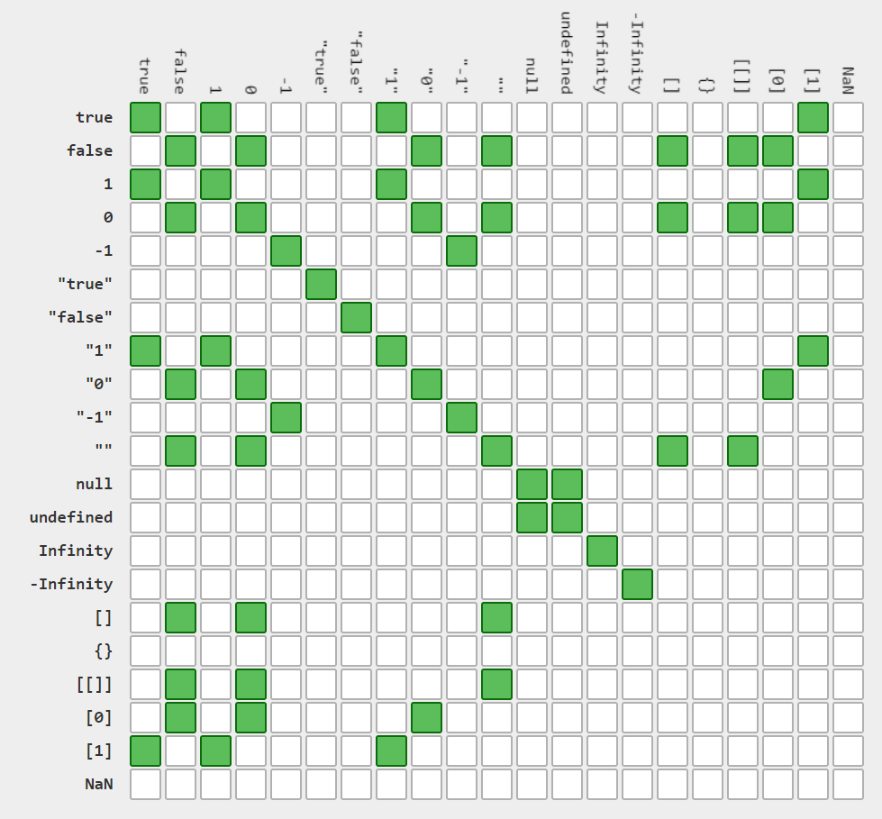
http://dorey.github.io/JavaScript-Equality-Table/
JavaScript
Equality
Table

Slide 36
DEMO
Truthy and Falsey
Notes:
Let's look at how JavaScript compares some values with both the standard equality operator and the exactly equals operator.
I'll paste in some expressions that log their output
First, does 0 == '' (zero = empty string). The equality operator says yes and exactly equals says no. **
0 == '0' // true (zero and quoted zero, that's ) Again, The equality operator says yes and exactly equals says no.
false == 'false' // false (does false = a quoted false) That's a result of false on both lines of code,
false == '0' // true (does false = quoted zero) That's conflicting results between the operators
false == undefined is in agreement between them as is false == null
But null == undefined is true for equals but false for exactly equals, and the oddest of all, ' \t\r\n ' == 0 // true (tab, carriage return, new line) DOES equal zero, sometimes. But not really.
(reverse operands and try ===) **

Slide 37
Just what's up with this, anyway?
Notes:
Many folks try to treat "this" the same way that it works in other languages and their notion of this is normally static and at the class level. JavaScript is different though, as this works based on the context of the calling code.
Usually this belongs to the window, or global object, but it can also be the HTML element that has caused an event, for example, a button causing a click event. Then the function is owned by that source element and that element becomes this.
To go a little deeper
JavaScript functions run in an execution context that goes on the stack. The stack is an in memory storage location for variables and data.
Functions are also values, and they're treated like objects/values.
What this means is that each time another function runs, it gets pushed onto the stack and the context for "this" changes. That's unlike other languages where this is usually clearly defined.
So the value of this depends on 2 things: What kind of code is executing? (global, function, or eval) and the calling code.
*******
ES5 introduces the a way that you can set the value of "this" in a function, as the first argument of the call.
Here in the IE console we have a function called saySomething that accepts a string and logs both this and the string to form a sentence about what this . Let's see it work.
Now that I've run the function I can call it and make 'this' a programmer or a trekkie or katniss everdeen. Not that you'd wants strings to be this bit
function saySomething(thing) {
console.log(this + " says " + thing);
}
saySomething.call("A programmer", "Hello world");
saySomething.call("A Trekkie", "Live long and prosper.");
saySomething.call("Katniss Everdeen", "May the odds be ever in your favor");
saySomething.call("A ghost", "Boooooooo!");

Slide 38
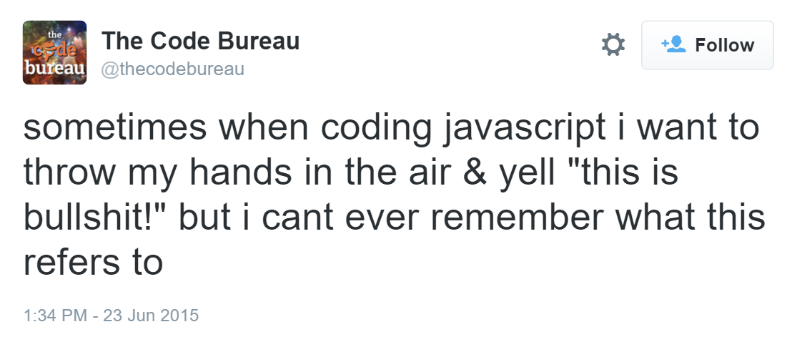
Sometimes when I'm writing JavaScript, I just want to throw my hands up and yell "This is bullshit!", but I can never remember what "this" is referring to.

Slide 39

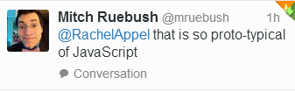
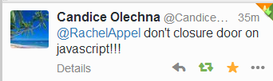

Slide 40
DEMO
this

Slide 41
You can force this.

Slide 42
DEMO
this again

Slide 43
Eval or Evil?
Improper use is a potential security threat
Code is slower
A challenge to debug

Slide 44
DEMO
Eval

Slide 45
Are you with me, or against me?
with (objX) {
// statements
}
Who does that?!?
Notes:
Just like in VB, JS has a with statement. This statement allows you to block off some code to work directly with variables using a shortened syntax. While this seems like a feature it usually ends up confusing developer rather than helping. For one, it's sporadic and inconsistent usage makes it difficult as it rarely adheres to any company or teams coding standards.

Slide 46
New, new, don't do
typed wrappers
new array
Use {} or [] instead
Notes:
Show in IE F12 tools
Using [] array literals means the interpreter creates a new runtime structure
Using new calls the Array constructor which creates the structure
It creates a new object. The type of this object, is simply object.
It sets this new object's internal, inaccessible, [[prototype]] property to be the constructor function's external, accessible, prototype object (every function object automatically has aprototype property).
It executes the constructor function, using the newly created object whenever this is mentioned.
It returns the newly created object, unless the constructor function returns a non-primitive value. In this case, that non-primitive value will be returned.

Slide 47
DEMO
A new look at performance

Slide 48
farceInt(fib,lie);
static int parseInt(String s)
static int parseInt(String s, int radix)
Notes:
parseInt is a function that accepts a string and parses it to ensure it is an integer. It has two method signatures, one which accepts only the string to convert, and the next accepts a string and a radix, or base, such as base 2, or base 10. Most software runs perfectly fine in base 10 systems and we normally don't need to specify that as the default. However, parseInt doesn't rely on what the system defaults are to perform its duty. Rather, parseInt assumes the radix based on the following rules: [next slide]

Slide 49
parseInt's farce parsing
If it begins with
parseInt uses
0X or 0x
16 (hexadecimal)
0
10 (decimal)
8 (octal)
Everything else
10 (decimal)
var result = parseInt(inputString, radix);
Notes:
If radix is undefined or 0 (or absent), JavaScript assumes the following:
If the input string begins with "0x" or "0X", radix is 16 (hexadecimal) and the remainder of the string is parsed.
If the input string begins with "0", radix is eight (octal) or 10 (decimal). Exactly which radix is chosen is implementation-dependent. ECMAScript 5 specifies that 10 (decimal) is used, but not all browsers support this yet. For this reason always specify a radix when using parseInt.
If the input string begins with any other value, the radix is 10 (decimal).
Your choice is to try to memorize all these facts or, just make it a rule that you specify a radix when using parseInt. The syntax will look something like this [show sample] It seems the latter is far easier to remember, code, and maintain.
As an example of parseInt's craziness, let's examine a sample from the Mozilla Developer center of 15 different calls
https://developer.mozilla.org/en-US/docs/Web/JavaScript/Reference/Global_Objects/parseInt
parseInt("2A",16);
parseInt("2A", 8);
---
parseInt("2A",16); // 42
parseInt("2A", 10); // 2
parseInt("2A", 8); // 2
parseInt(42.99, 10); // 42
---
from Mozilla
parseInt(" 0xF", 16);
parseInt(" F", 16);
parseInt("17", 8);
parseInt(021, 8);
parseInt("015", 10);
parseInt(15.99, 10);
parseInt("FXX123", 16);
parseInt("1111", 2);
parseInt("15*3", 10);
parseInt("15e2", 10);
parseInt("15px", 10);
parseInt("12", 13);
console.log(parseInt(" 0xF", 16));
console.log(parseInt(" F", 16));
console.log(parseInt("17", 8));
console.log(parseInt(021, 8));
console.log(parseInt("015", 10));
console.log(parseInt(15.99, 10));
console.log(parseInt("FXX123", 16));
console.log(parseInt("1111", 2));
console.log(parseInt("15*3", 10));
console.log(parseInt("15e2", 10));
console.log(parseInt("15px", 10));
console.log(parseInt("12", 13));

Slide 50
DEMO
parseInt

Slide 51
parseInt
parseInt(" 0xF", 16);
parseInt(" F", 16);
parseInt("17", 8);
parseInt(021, 8);
parseInt("015", 10);
parseInt(15.99, 10);
parseInt("FXX123", 16);
parseInt("1111", 2);
parseInt("15*3", 10);
parseInt("15e2", 10);
parseInt("15px", 10);
parseInt("12", 13);
These all return 15

Slide 52
parseInt
parseInt("-F", 16);
parseInt("-0F", 16);
parseInt("-0XF", 16);
parseInt(-15.1, 10)
parseInt(" -17", 8);
parseInt(" -15", 10);
parseInt("-1111", 2);
parseInt("-15e1", 10);
parseInt("-12", 13);
These all return -15

Slide 53
NaN
NotANumber
It is a liar
typeof will tell you
Notes:
typeof NaN === "number“ //true
NaN == NaN // false
NaN === NaN // false

Slide 54
NaN
NaN does not equal itself
Don't use equality operators with NaN
(var == NaN) will not work
(var === NaN) will not work
ES6 Number.isNaN or isNaN

Slide 55
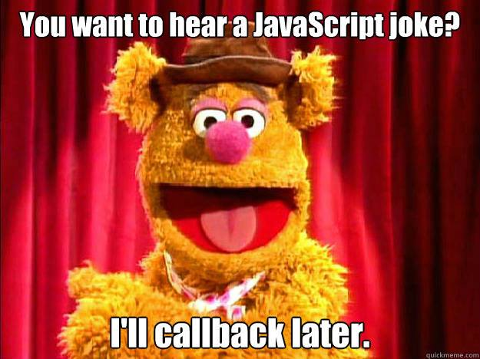

Slide 56
Seems legit
var add = function() {
return arguments[0] + arguments[1];
};
Is legit
console.log(add(4, 4)); // returns 8
Notes:
It's not a main()

Slide 57
How do you avoid all this crazy nonsense?
Linting to the rescue!
JSLint |JSHint |JSFiddle
Notes:
With all these crazy things that JS does, we need to ensure our code actually works! As you've learned, JS has enough rules that memorizing them is a daunting task. That's no problem though, as we have tools to help us verify (or lint), our code.
JSFiddle – Of course I've been using this throughout the course. JSFiddle as you know is an online playground that lets you work with html, css, and js, of course, all online. What we didn't talk about is that can save code and perform some linting with JSHint to test out again later.
JSLint – This is another online utility by Douglas Crockford (author of a famous JS book called "Javascript The good parts")
JSHint – JSLint is quite sharp and stricts, so JSHint is a lightweight version of JSLint.
Of course if you develop software for a company you might use Visual Studio that has linting options and tools, as well as Jet Brain's editor named Web Storm.
No longer will you be stuck when JavaScript decides to misbehave.
You've learned that Javascript has many quirks from simply annoying to downright nasty. To make sure that JavaScript is used correctly and effectively by your team, balance their styles and skills against the many gotchas you've learned here. Just as well you can use JSLint and JSHint to your advantage to assist you in writing better code!

Slide 58
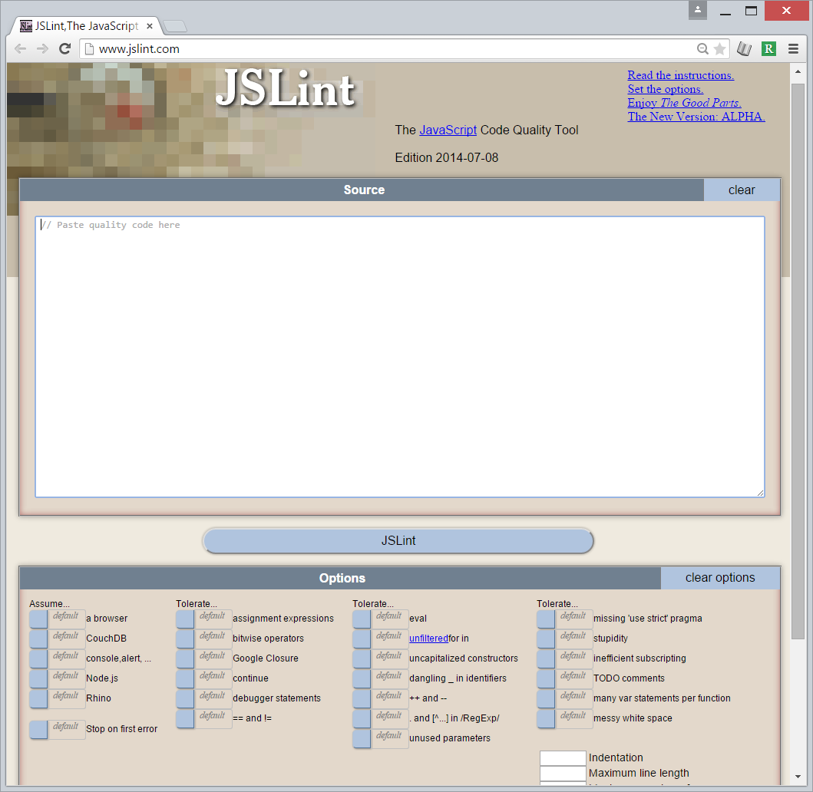
JSLint

Slide 59
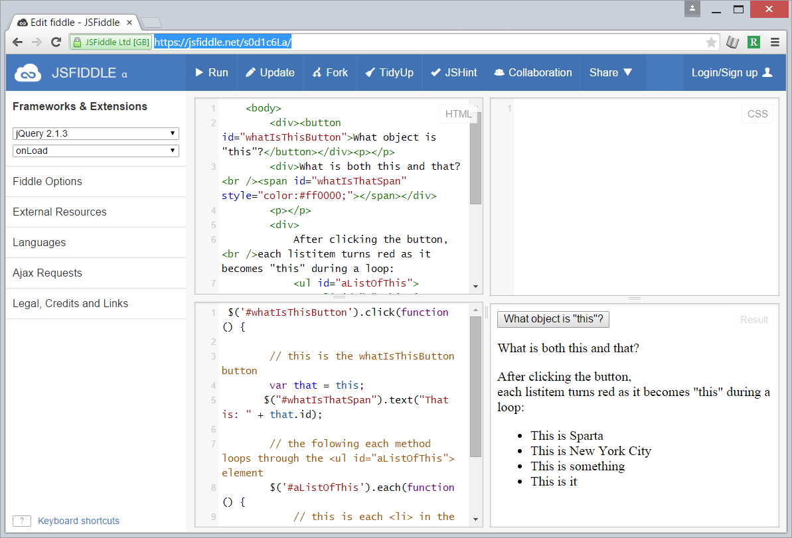
JSFiddle
Notes:
https://jsfiddle.net/s0d1c6La/

Slide 60
Thank You!
Questions?

